Slide 1
SDN-based Malicious Network Traffic Defender
Name: Prashanth Rajasekar 011822460

Slide 2
Motivation
To build an application act as a firewall, simultaneously monitor the traffic and assign the threshold, and blocks the IP address which breaches the assigned threshold value.
We can configure the firewall using the application.
Command used:
Detele the rules
Reset
List all the existing rules
Monitoring
To continuously monitor the traffic flow (Normal, DDoS).

Slide 3
Environment
Ubuntu 16.04 xenial-64bit
Mininet 2.3.0d1
Floodlight
sFlow
Python 2.7

Slide 4


Floodlight REST API
Firewall Application
1. Defining flows and threshold value
2. Monitor OpenFlow switch using sFlow
3. Receiving an event from sFlow
4. Deploy control and release control
sFlow REST API

Slide 5
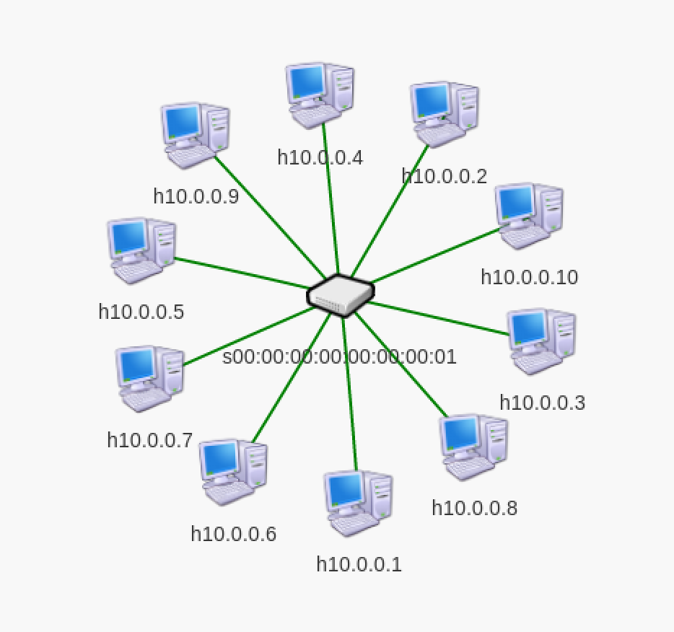


Topology
Mininet
127.0.0.1:8080
127.0.0.1:6653
127.0.0.1:6343
127.0.0.1:8008

Slide 6




Applications
REST API
sFlow
HOST
Mininet
Network
Real time monitoring
Easy to program
Expandibility

Slide 7
Flow chart
START
Define flow & threshold (10K ICMP packet)
(Define to block anything)
[POST] to sFlow with REST API
[Get] event from sFlow with REST API
New event?
NO
YES
Retrieve flow from event
Construct the blocking flow entry
[POST] flow entry to Floodlight with REST API

Slide 8
Complete Outline
Firewall Application
REST API
Detection (Monitoring)
Mitigation (Inserting)

Slide 9
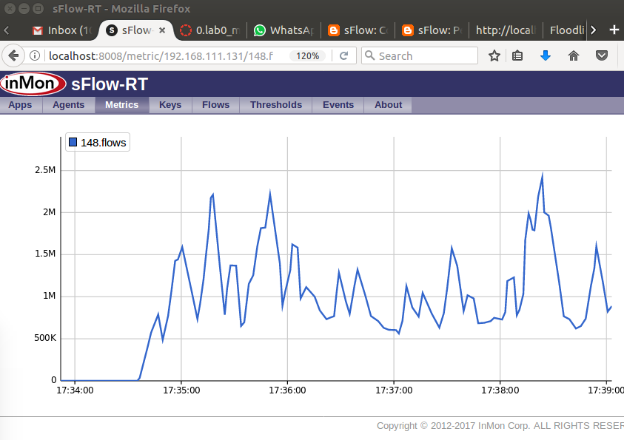
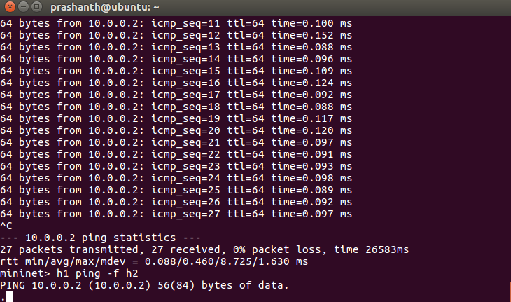
Firewall Application - Not Active
Monitoring without the firewall
Mininet command window

Slide 10
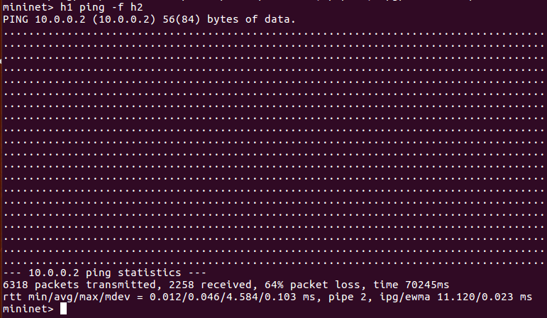
Firewall Application - Active
Procedure
Host 1 ping Host 2 (flooding)
Block by the program
Ping...but packet loss

Slide 11
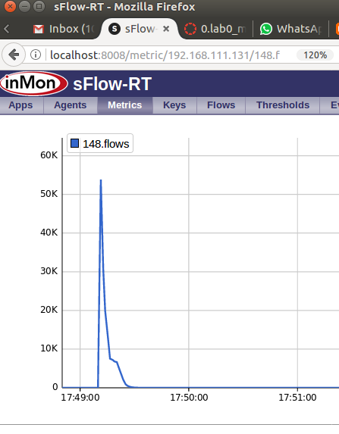
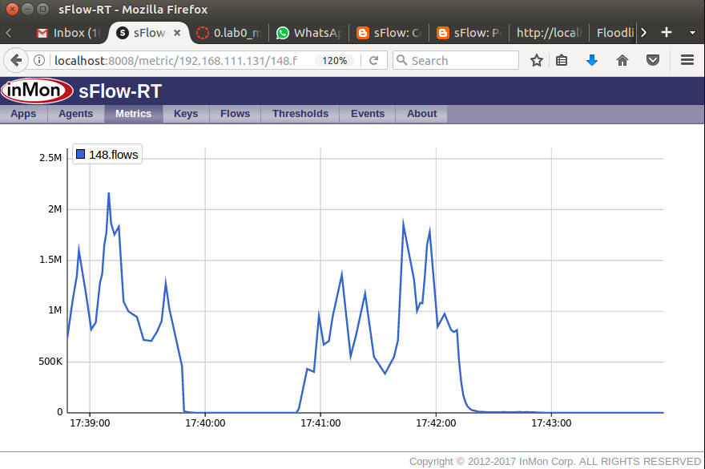
Firewall Application - Active
Monitoring with the firewall
Before program starts
Monitoring with the firewall
After program has started

Slide 12
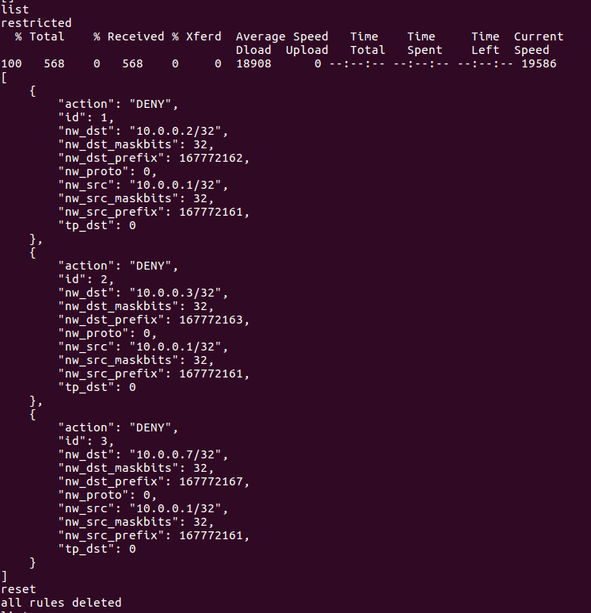
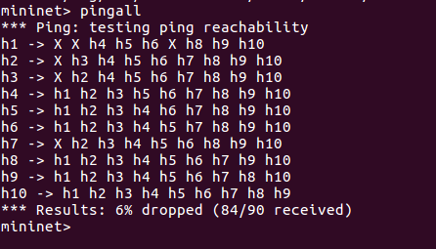
Firewall Application
Program can record the flow
List the flow that has been block
Source
Destination
Action
Id

